Slide 1
Adsorbing Hemoglobin in Column Flow Experiments – diff Eq analysis

Slide 2
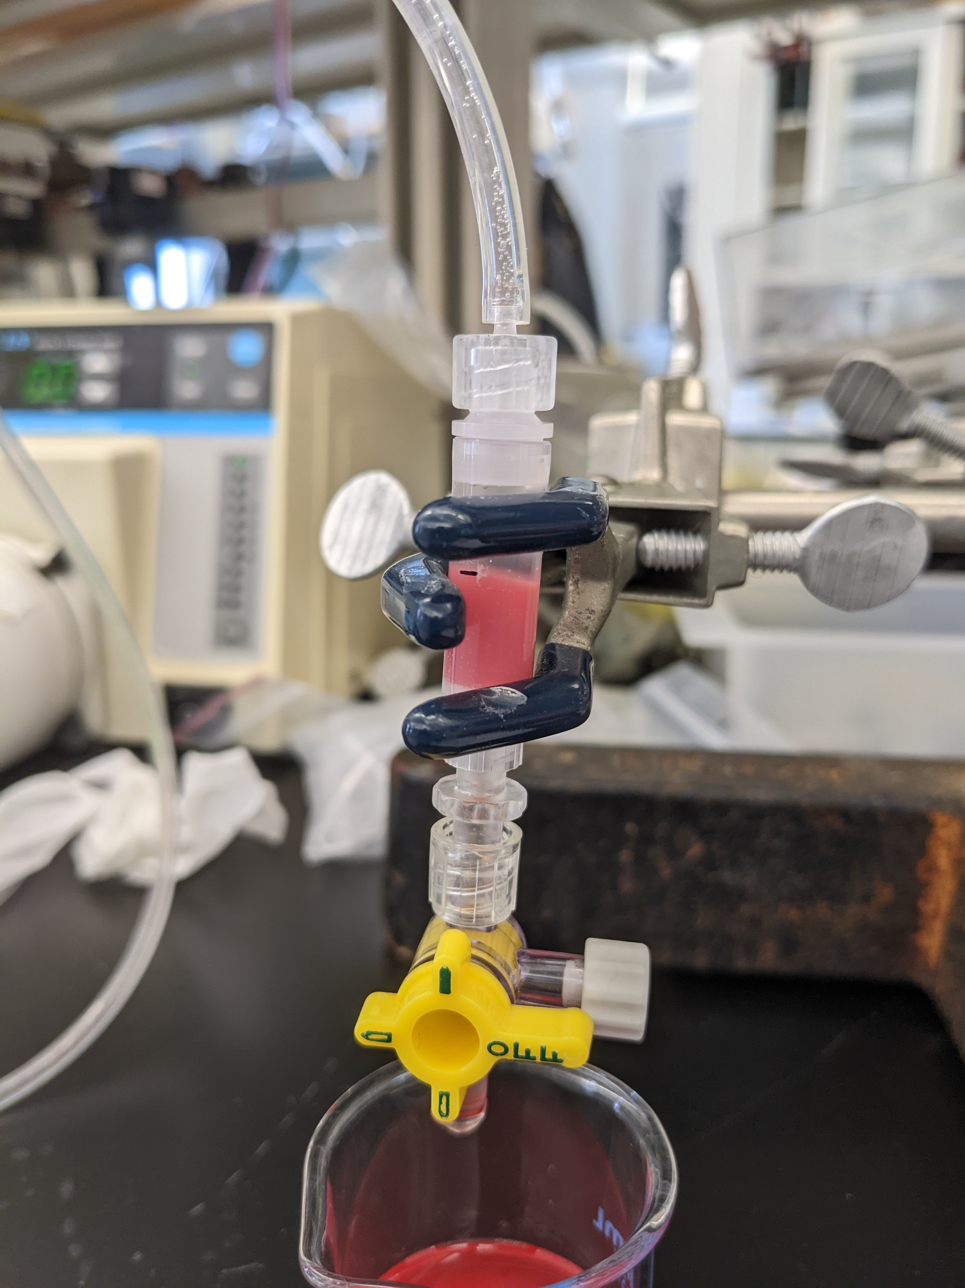
Background – Ex-vivo experiments
Columns are set up in PBS, tube primed with whole rat blood
Flow starts, outflow collected as sample per minute
Plasma hemoglobin concentration measured for haptoglobin-immobilized beads and control

Slide 3
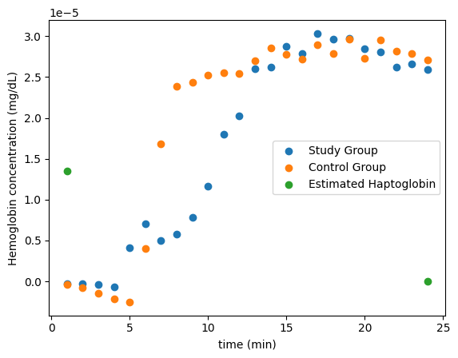
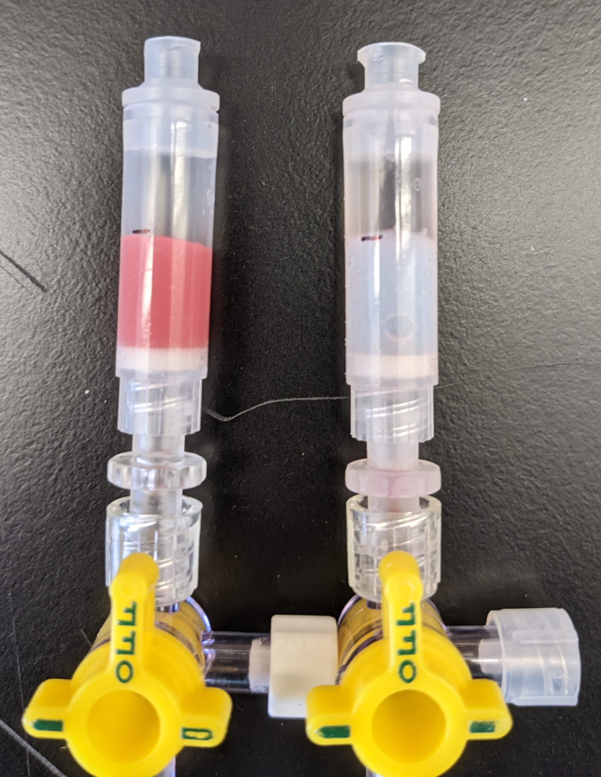
Data
Capture region

Slide 4

Kinetics
B = Hemoglobin in plasma – haptoglobin-bound bead group
P = Available haptoglobin on bead surface
C = Hemoglobin in plasma –control group
BP = Adsorbed hemoglobin-haptoglobin complex
0-D “reactor” kinetics:
$$B+P → BP$$
$\frac{d[BP]}{dt}=k_{r}[B][P$]
$$\frac{d[P]}{dt}=\frac{d[B]}{dt}=−k_{r}[B][P\text{]}$$
$$\frac{d[C]}{dt}=0$$

Slide 5
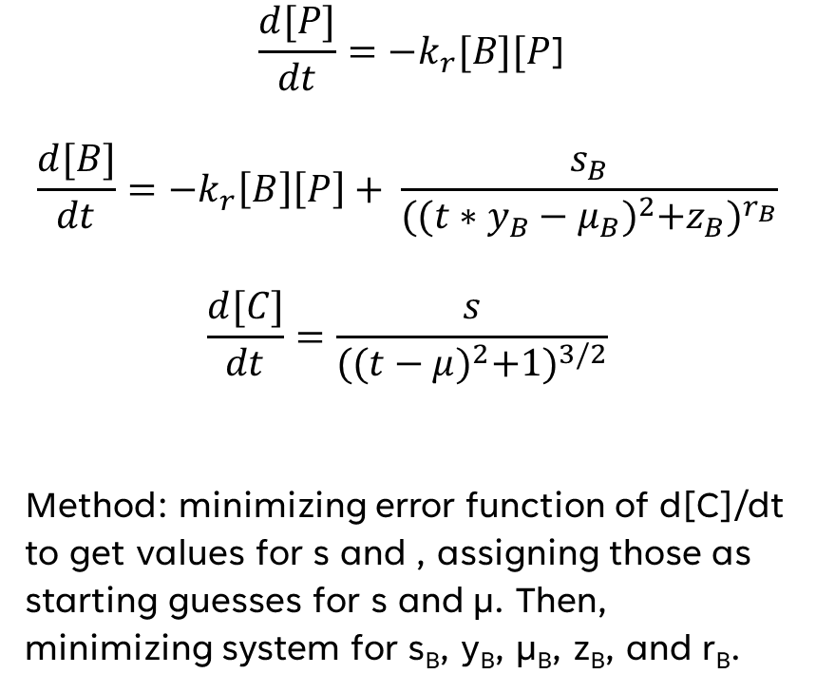
Primary model
Var. | Type | Significance | Value & units
t | IV | Time | 1-24 min
P | DV | Available bound haptoglobin | I.C.: 1.35E-05 mol/dL
B | DV | Plasma hemoglobin in study group (SG) | I.C.: -3.35E-07 mol/dL
C | DV | Plasma hemoglobin in control group (CG) | I.C.: -3.80E-07 mol/dL
k_{r} | OP | Reaction rate constant | 1.52E05 dL/(mol*s)
s_{B} | OP | Saturation value in SG | 4.57E-05
y_{B} | OP | Time scale in SG | 4.36E-01
µ_{B} | OP | Time shift in SG | 3.64E00 s
z_{B} | OP | Model adjustment in SG | 4.52E00
r_{B} | OP | Model adjustment in SG | 1.48E00
s | OP | Saturation value in CG | 1.38E-05
µ | OP | Time shift in CG | 7.00E00 s
$$\frac{d[P]}{dt}=−k_{r}[B][P\text{]}$$
$$\frac{d[B]}{dt}=−k_{r}\left[B\right]\left[P\right]+ \frac{s_{B}}{{({(t∗y_{B}−μ_{B})}^{2}+z_{B})}^{r_{B}}}$$
$$\frac{d[C]}{dt}=\frac{s}{{({(t−μ)}^{2}+1)}^{3/2}}$$
Method: minimizing error function of d[C]/dt to get values for s and , assigning those as starting guesses for s and µ. Then, minimizing system for s_{B}, y_{B}, µ_{B}, z_{B}, and r_{B}.

Slide 6
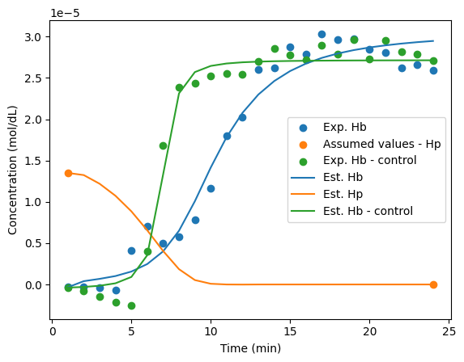
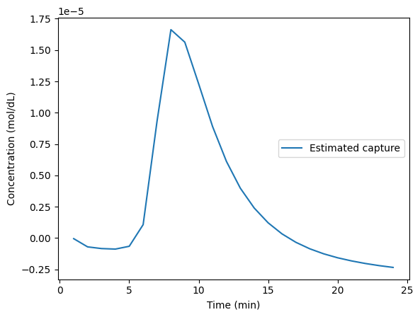
Accuracy of model

Slide 7
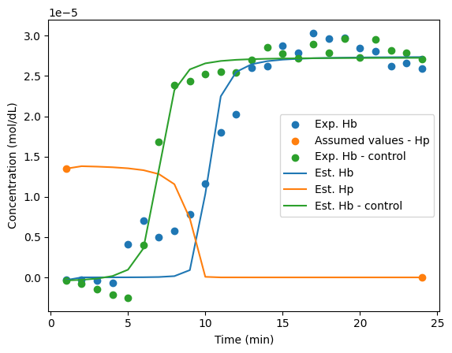
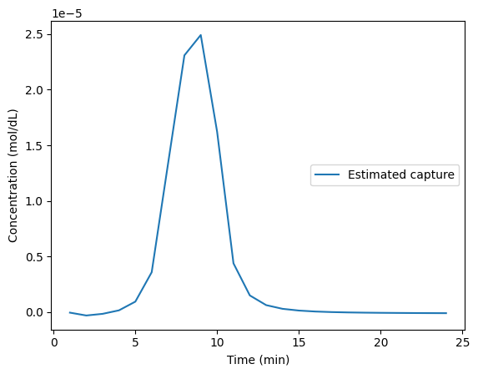
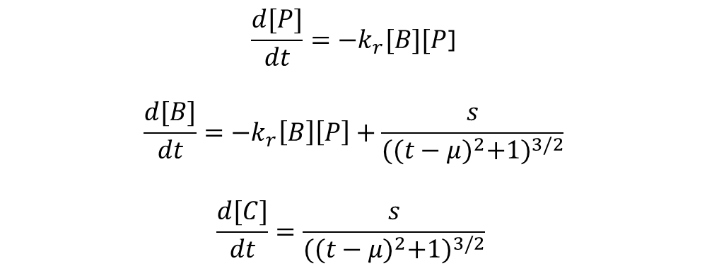
Other attempted model
$$\frac{d[P]}{dt}=−k_{r}[B][P\text{]}$$
$$\frac{d[B]}{dt}=−k_{r}\left[B\right]\left[P\right]+\frac{s}{{({(t−μ)}^{2}+1)}^{3/2}}$$
$$\frac{d[C]}{dt}=\frac{s}{{({(t−μ)}^{2}+1)}^{3/2}}$$

Slide 8
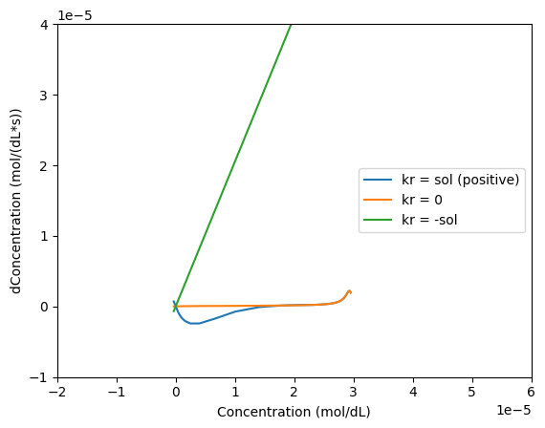
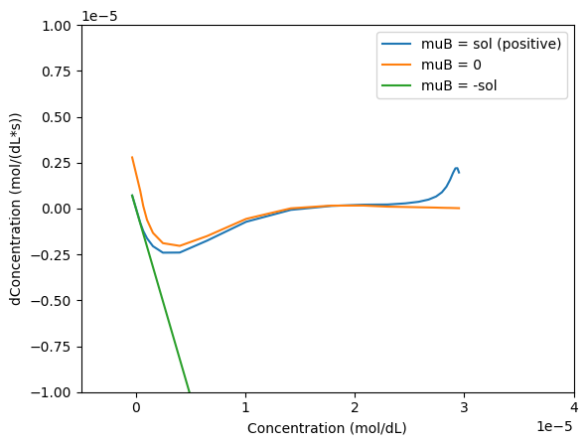
Bifurcation analysis
Stable
Unstable

Slide 9
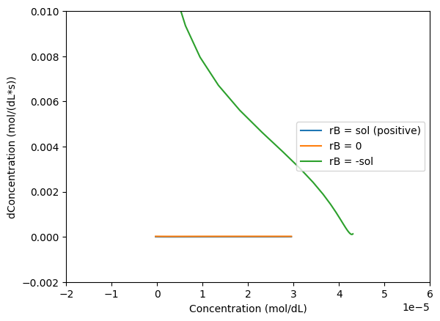
Bifurcation analysis Continued
Solutions follow extremely different paths over the test time range when parameters are bifurcated
Steadystates are most often found by 0 concentration – reaction is extremely stable when nothing happens

Slide 10
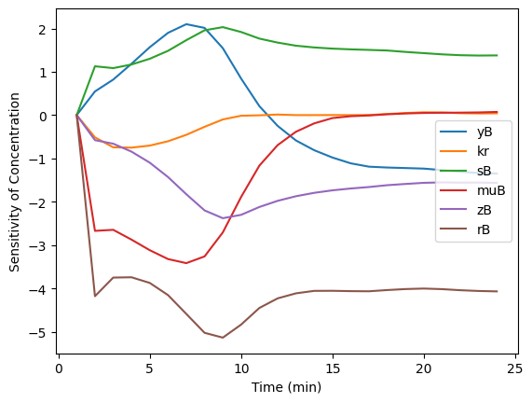
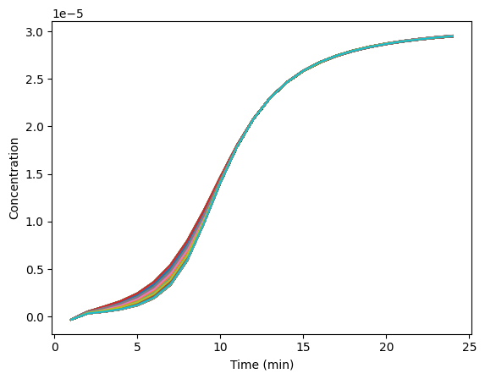
Parametric sensitivity
Sensitivity of Study Group Hemoglobin to different parameters
Effect of k_{r} on model solution

Slide 11
Limitations & next steps
Model needs refinement – close but not quite
Incorporate original unmodified data to include hemolysis term in analysis
Investigate importance of kr and previous analyses
Attempt analytical solution of concentration via transport & use better sigmoidal solution

Slide 12
THANK YOU
Work made possible by:
Dr. William Federspiel
Dr. Nahmah Kim-Campbell
Anna Maywar

